Slide 1
Master-Thesis Methodical Approach for Analyzing Process Parameters and Optimizing Boundary Conditions in Multi-Axis Robot Programs
Status Update: Week 10 (13 weeks left)
04.12.2023 – 12.12.2023
Jan Nalivaika

Slide 2
State of the Art Questions
Continuous-path mode ???
Changes: -
-
-
-
G-Code ??
Add / No Add

Slide 3
Writing progress
70 pages → Ludwig ☺

Slide 4
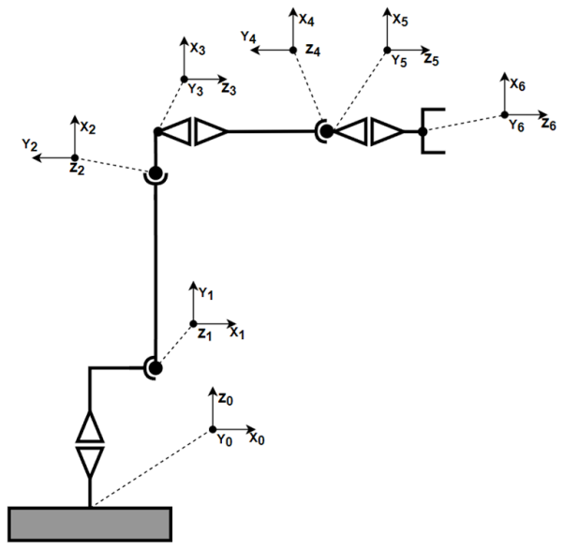
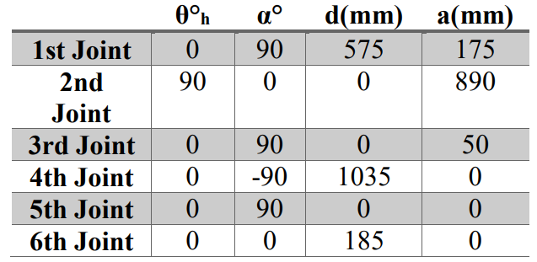
DH params

Slide 5
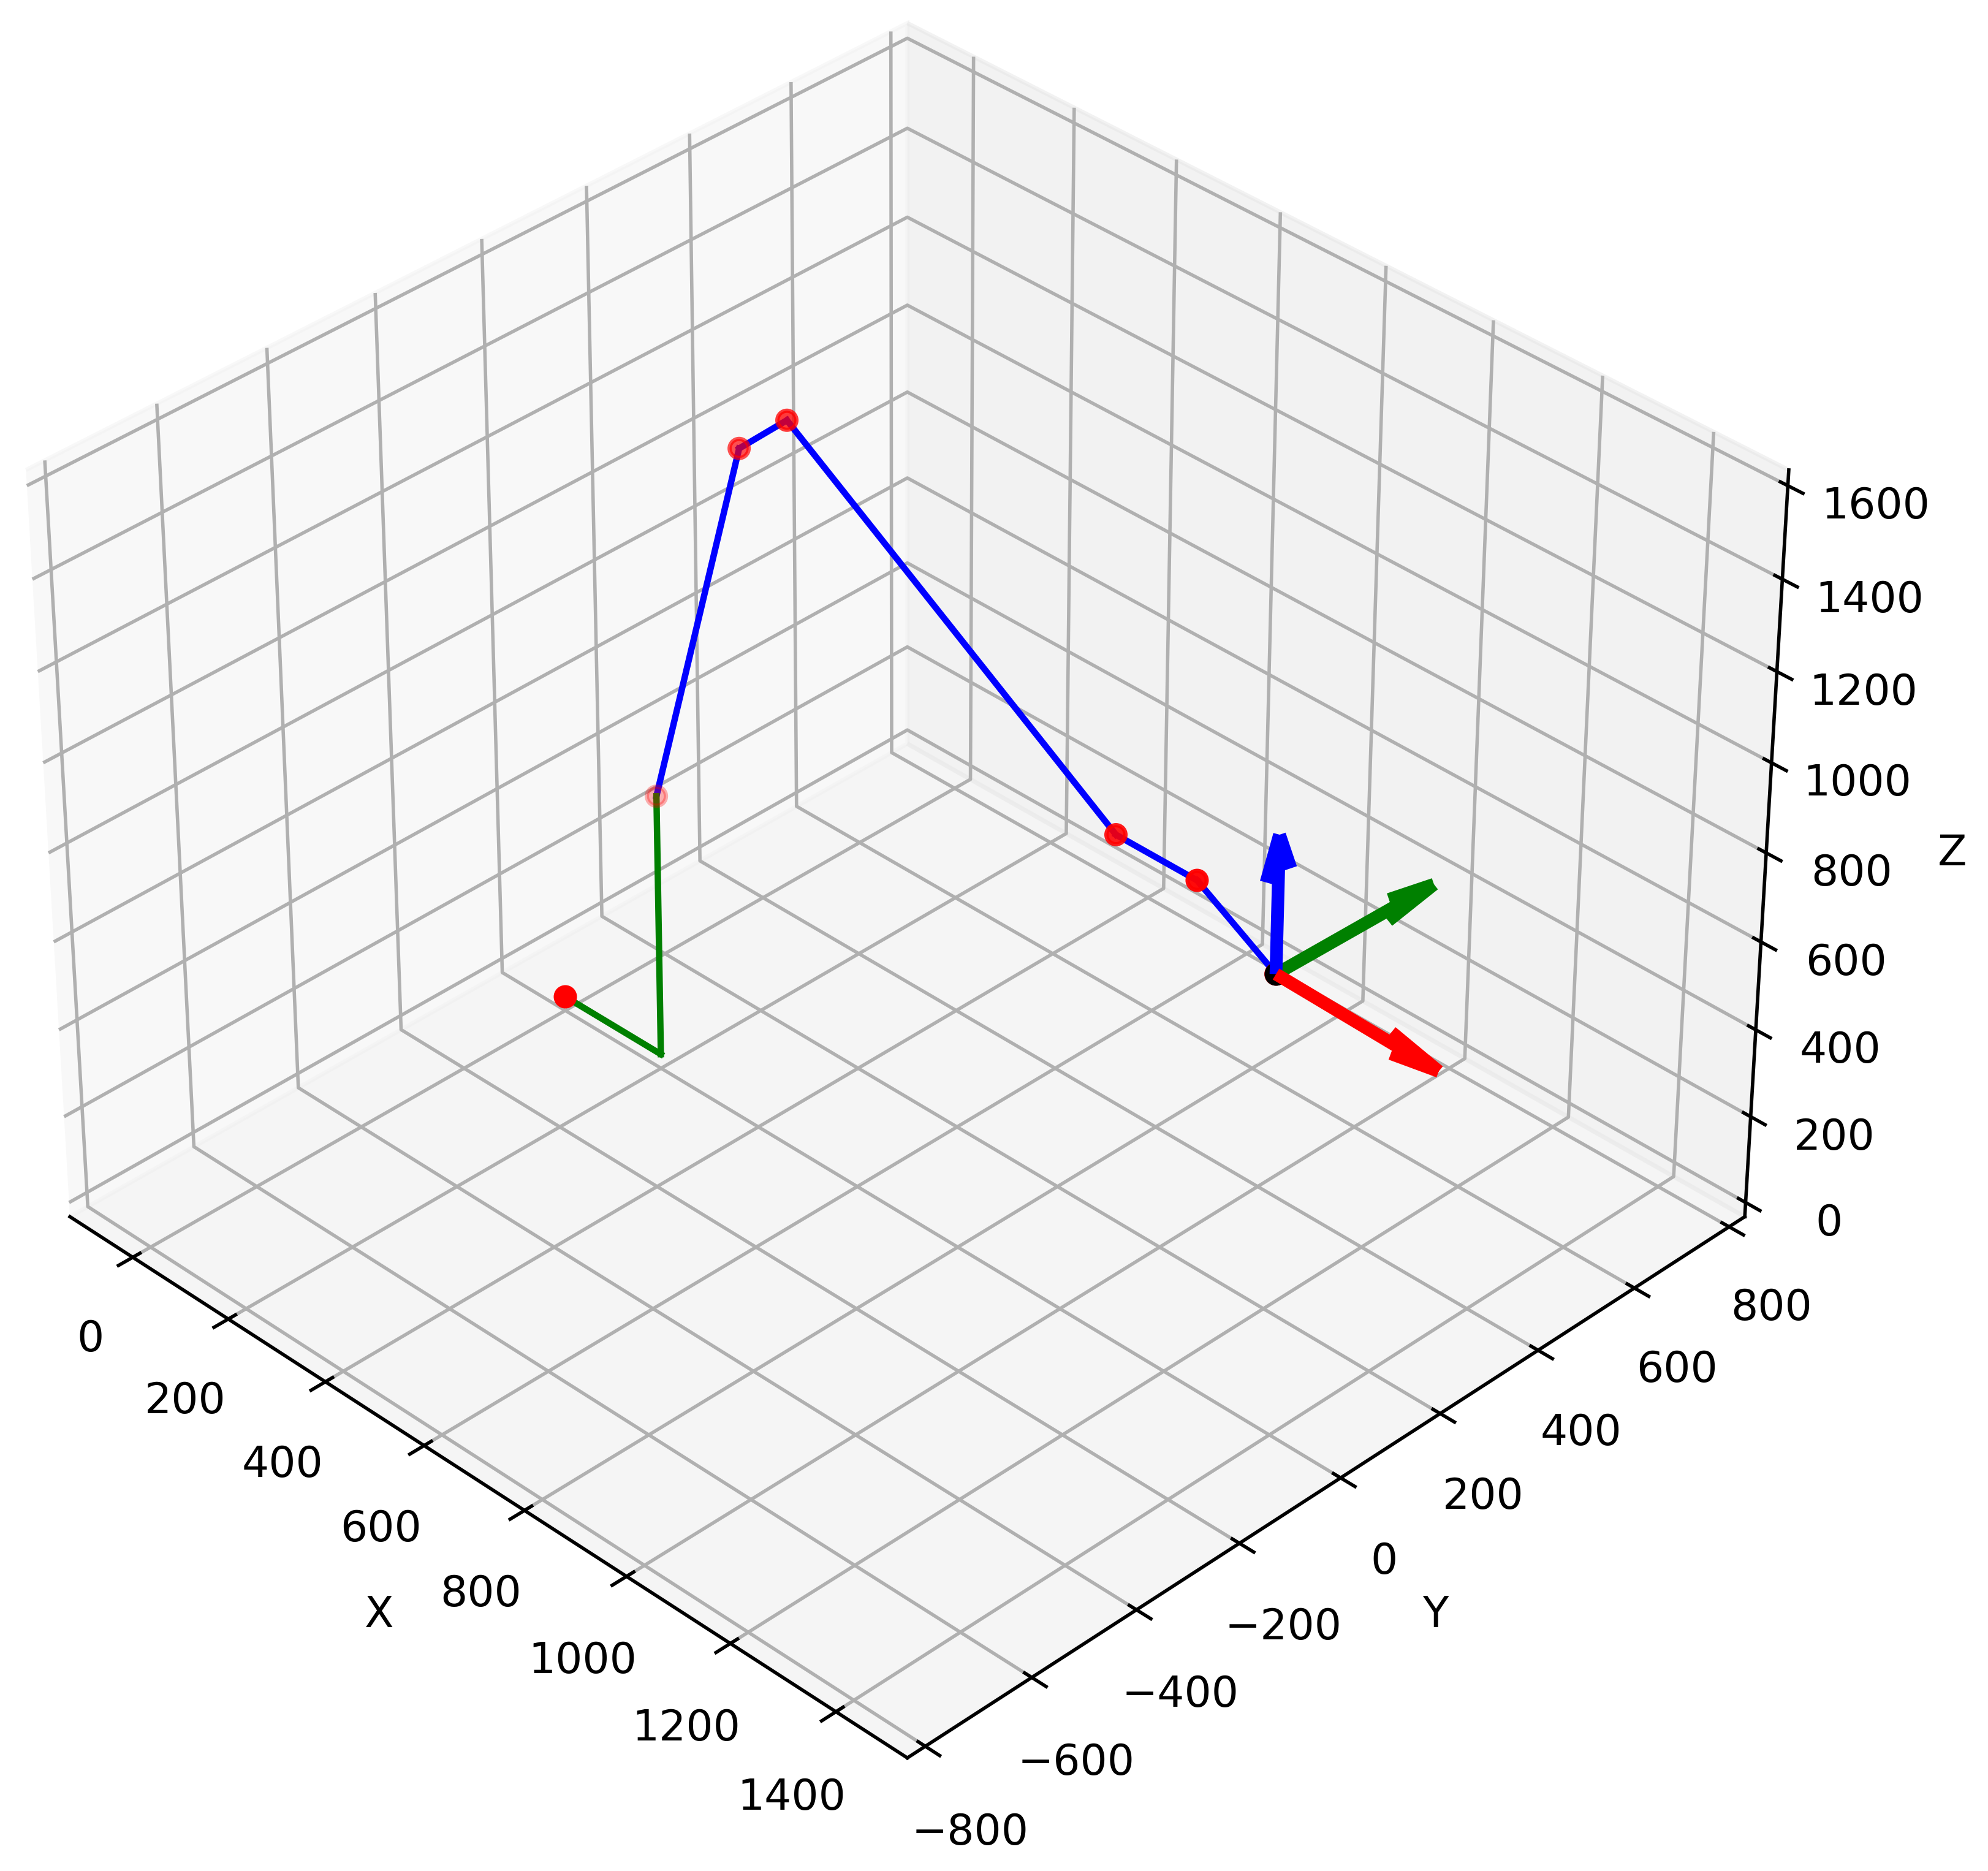
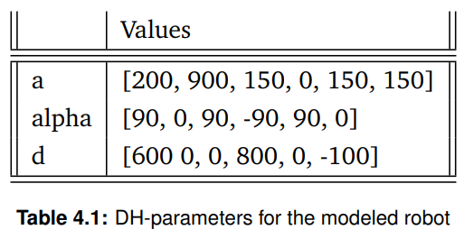
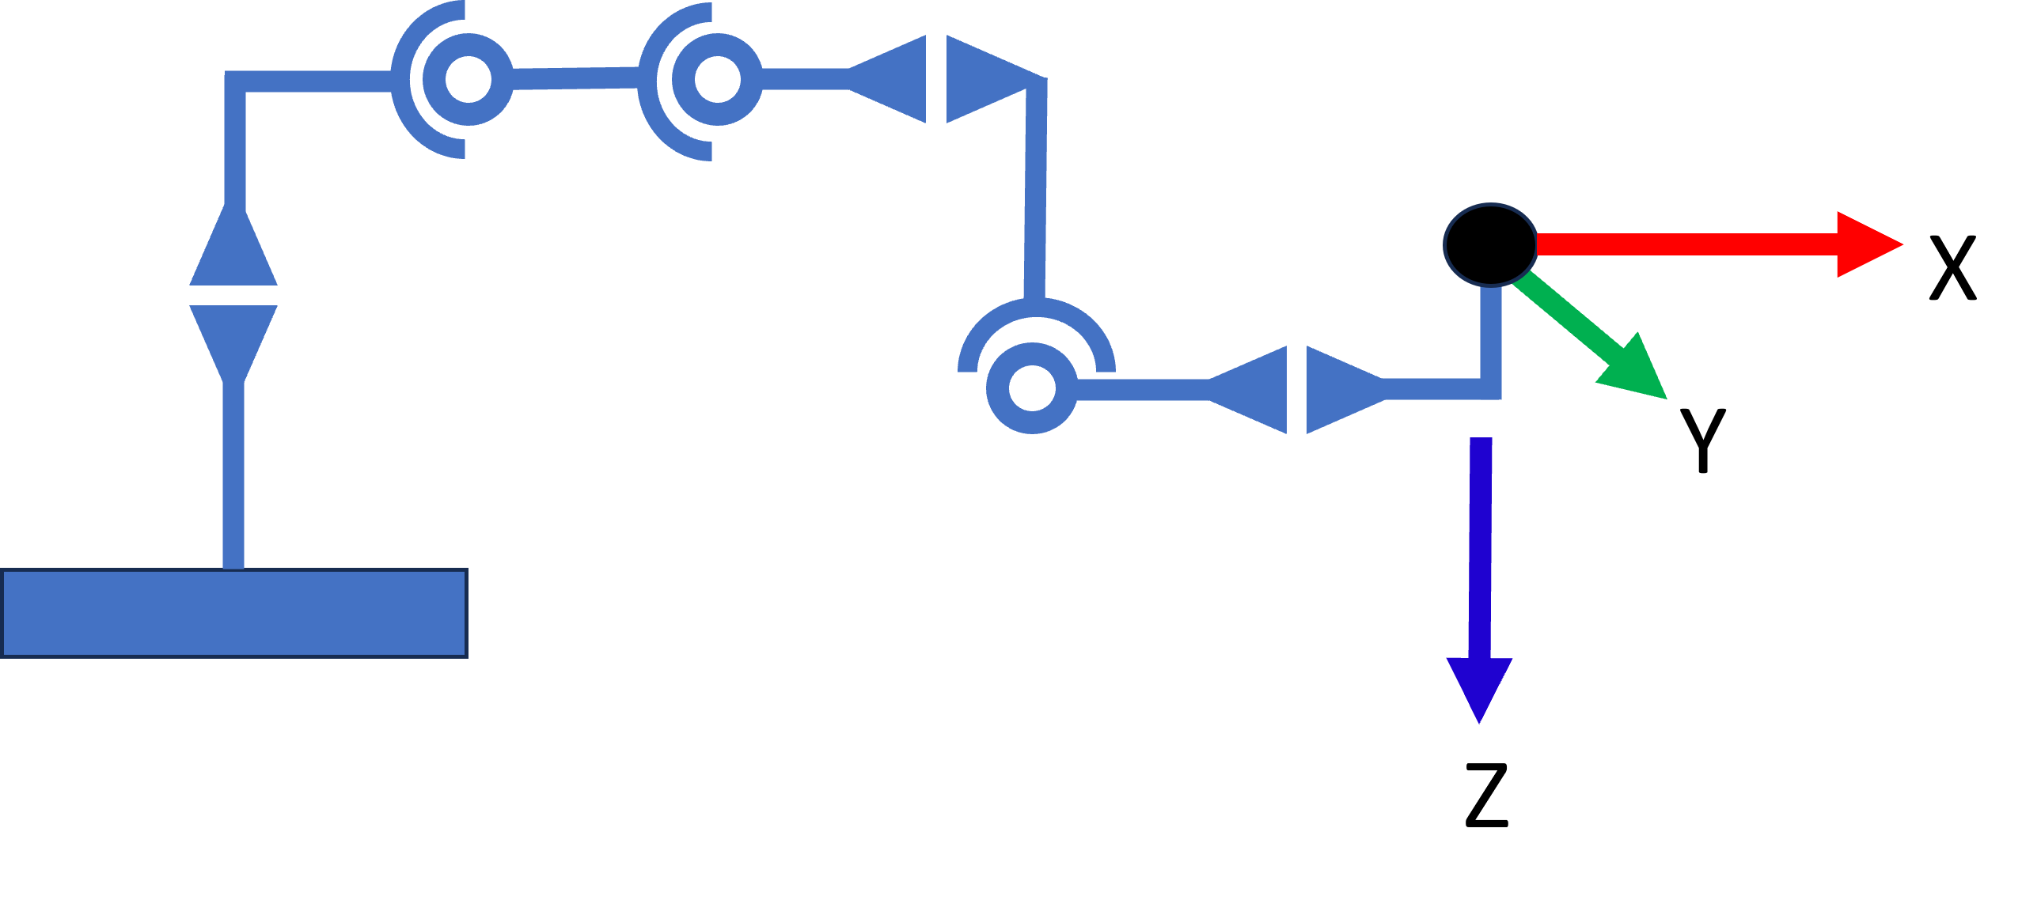
DH params

Slide 6


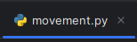
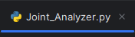
Progress:

Slide 7
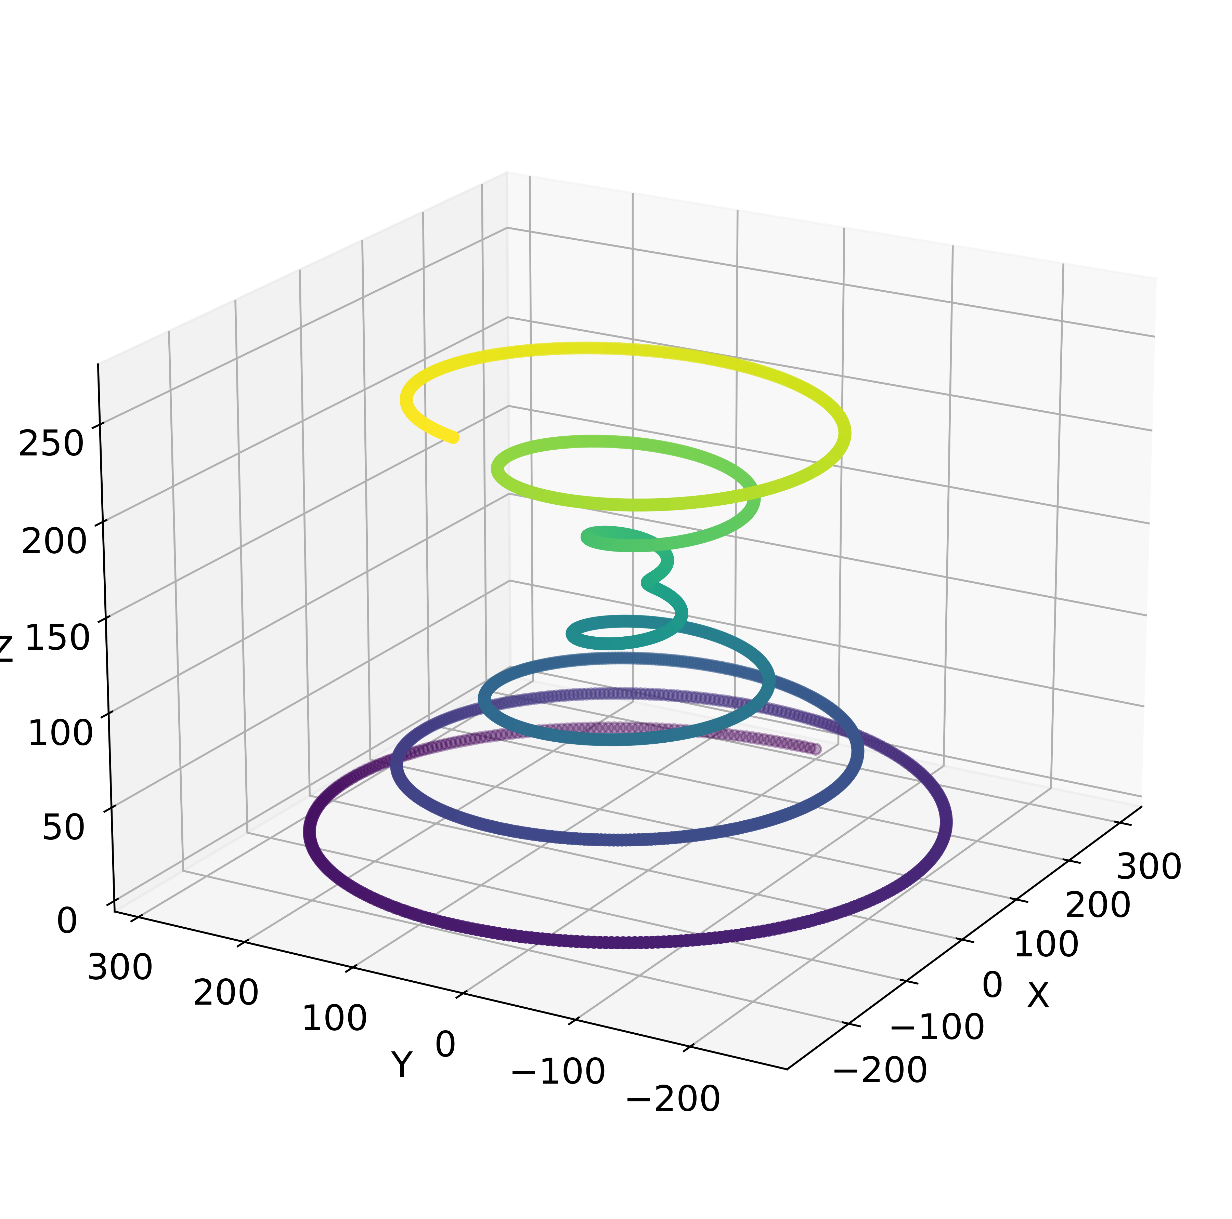
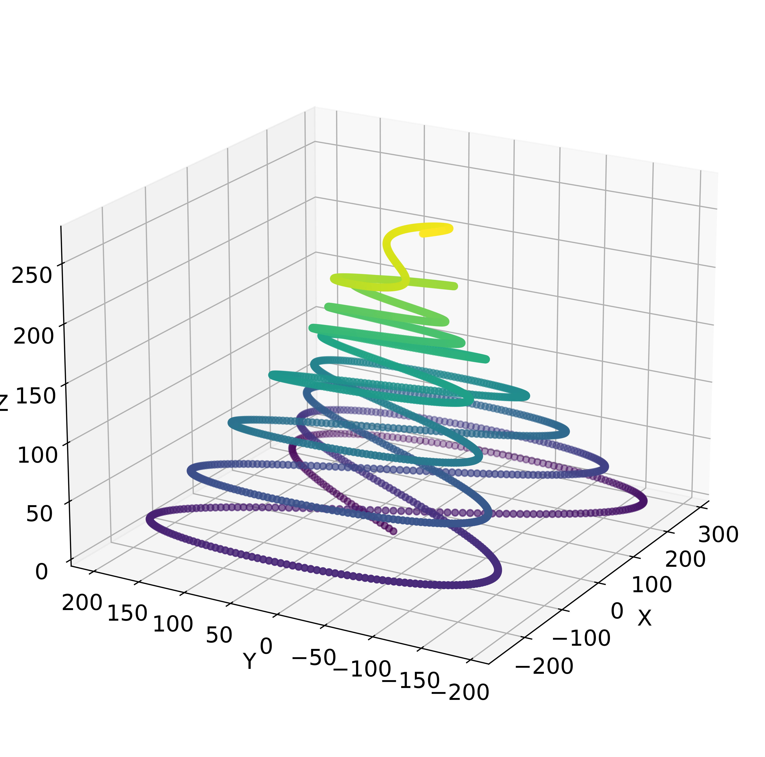
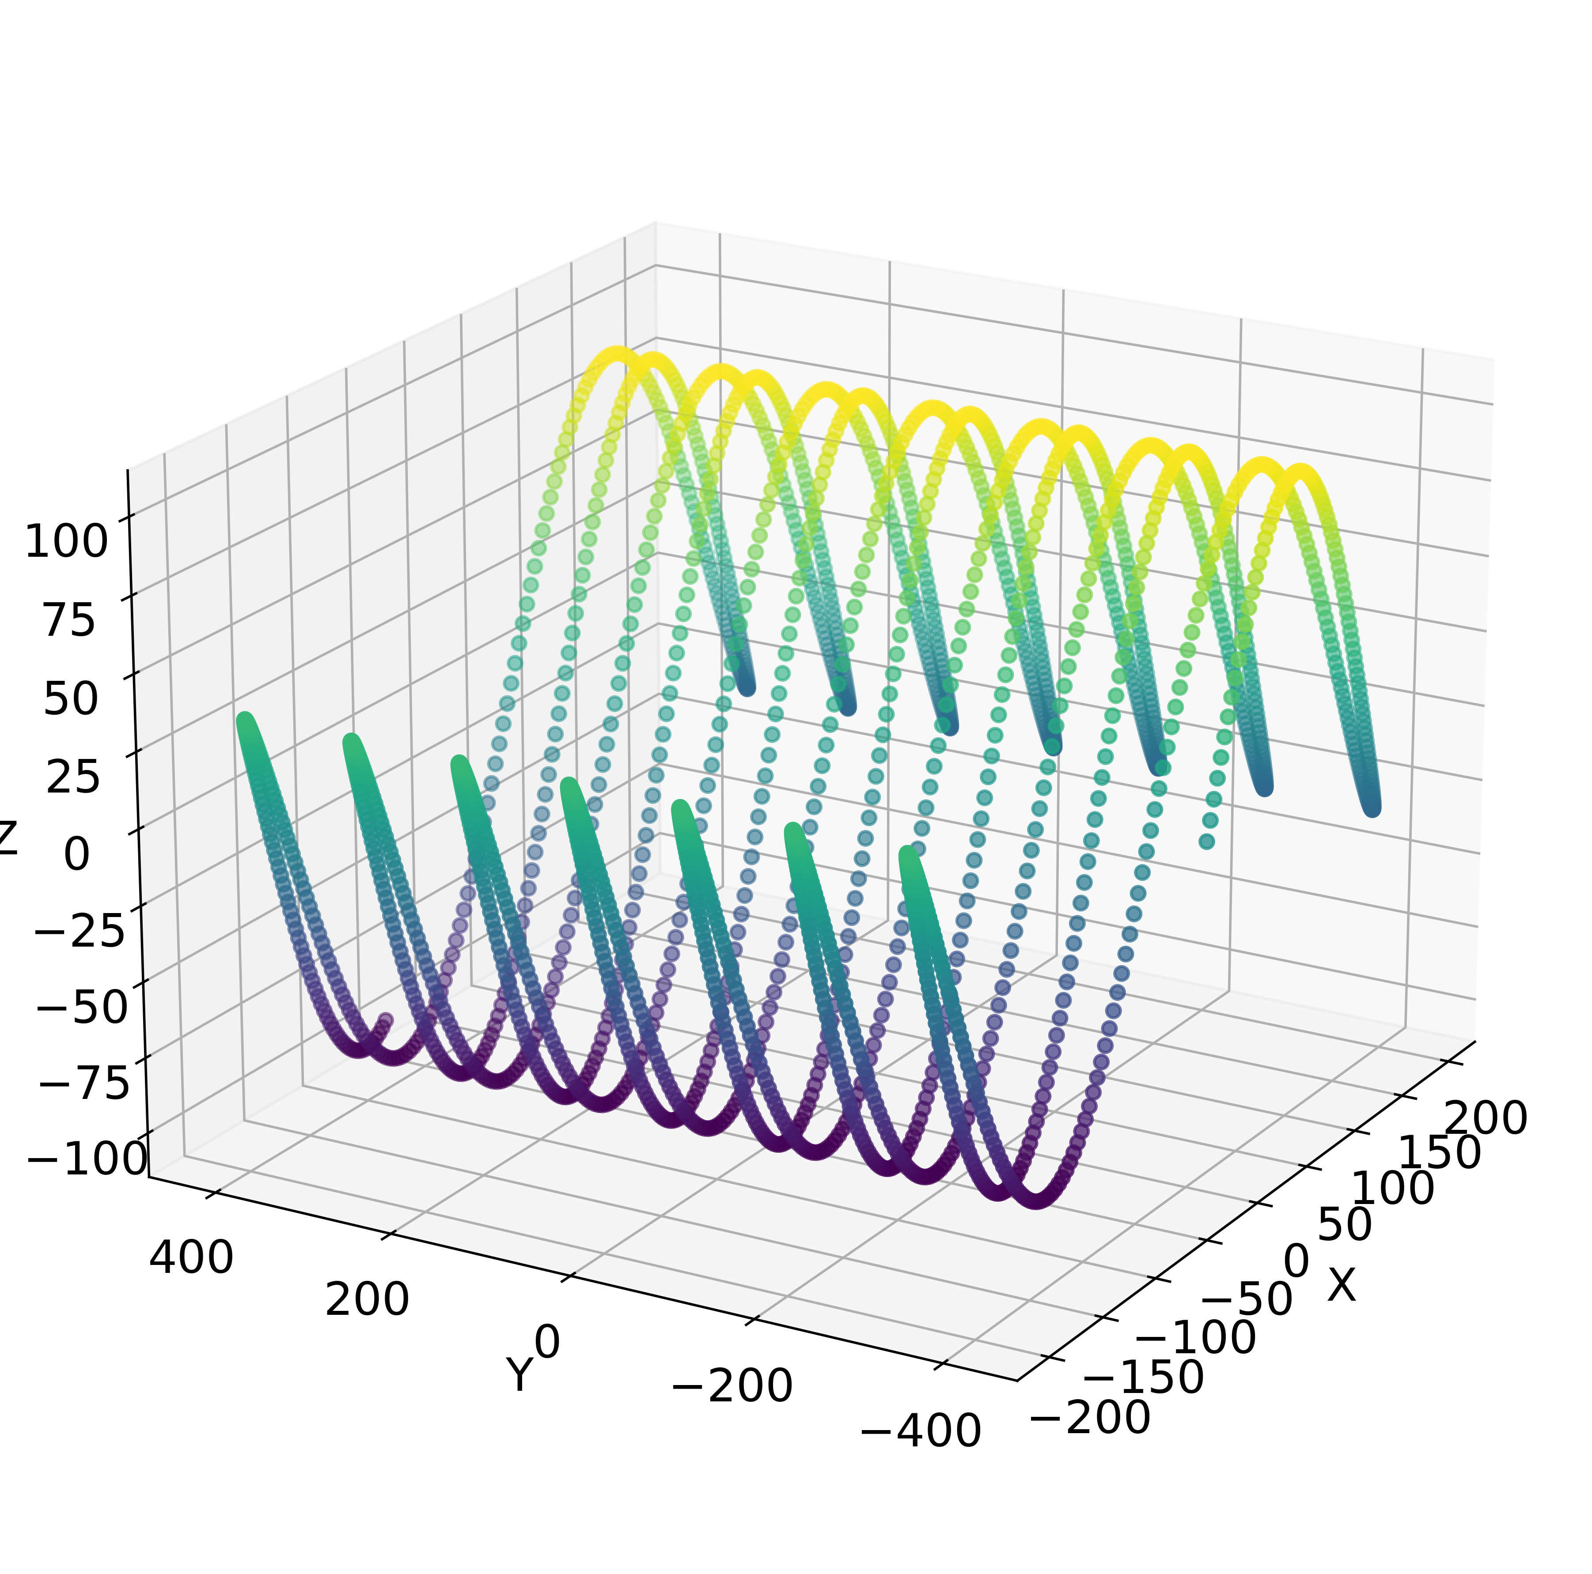
Progress:

Slide 8
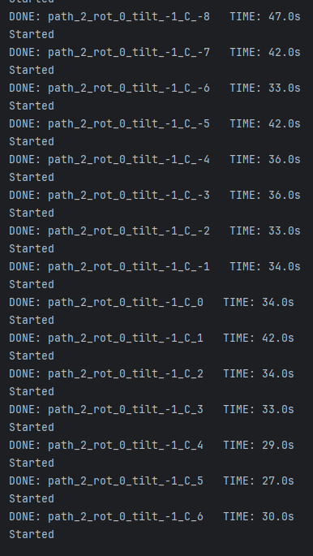
Progress:

Slide 9
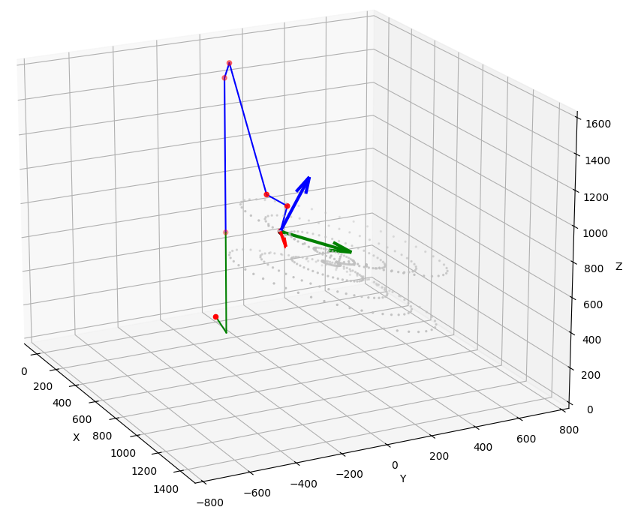
Progress:
Show cool video here

Slide 10
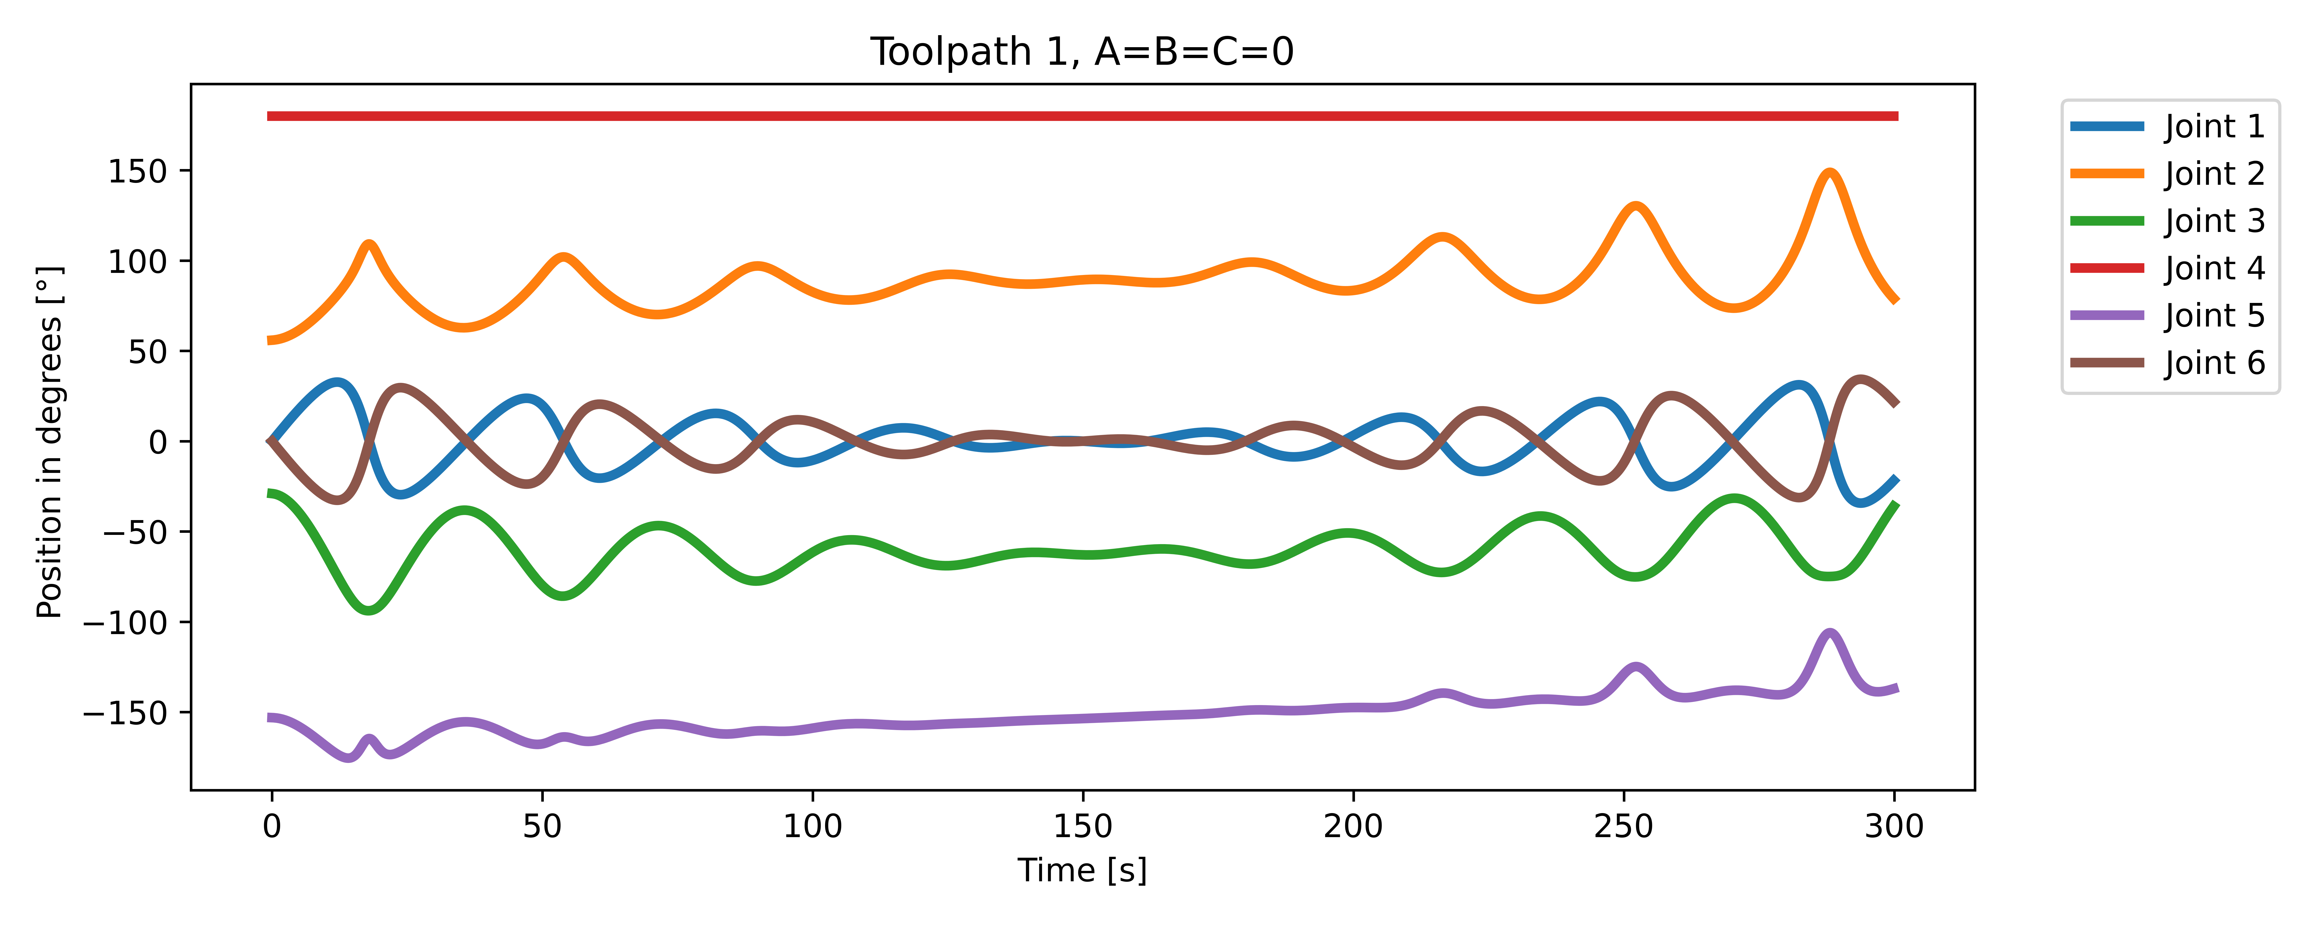
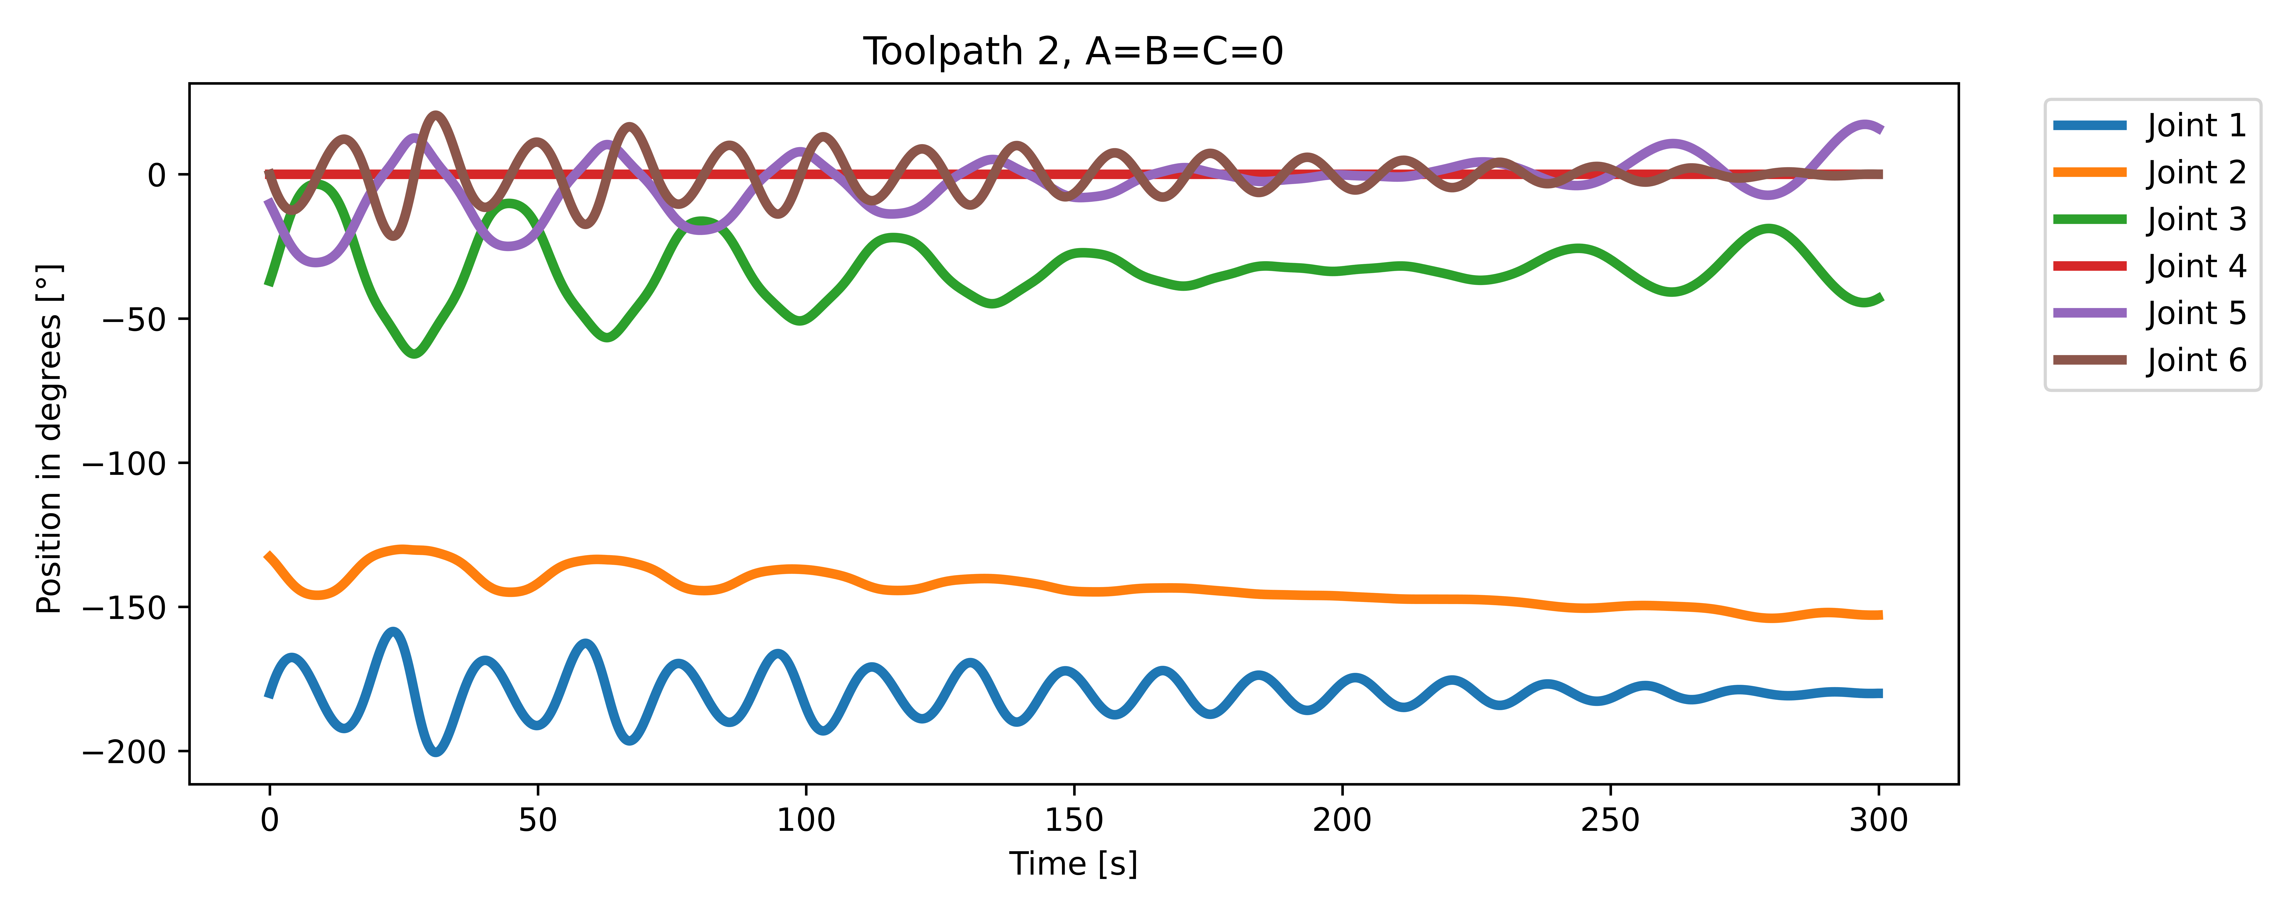
Progress:

Slide 11
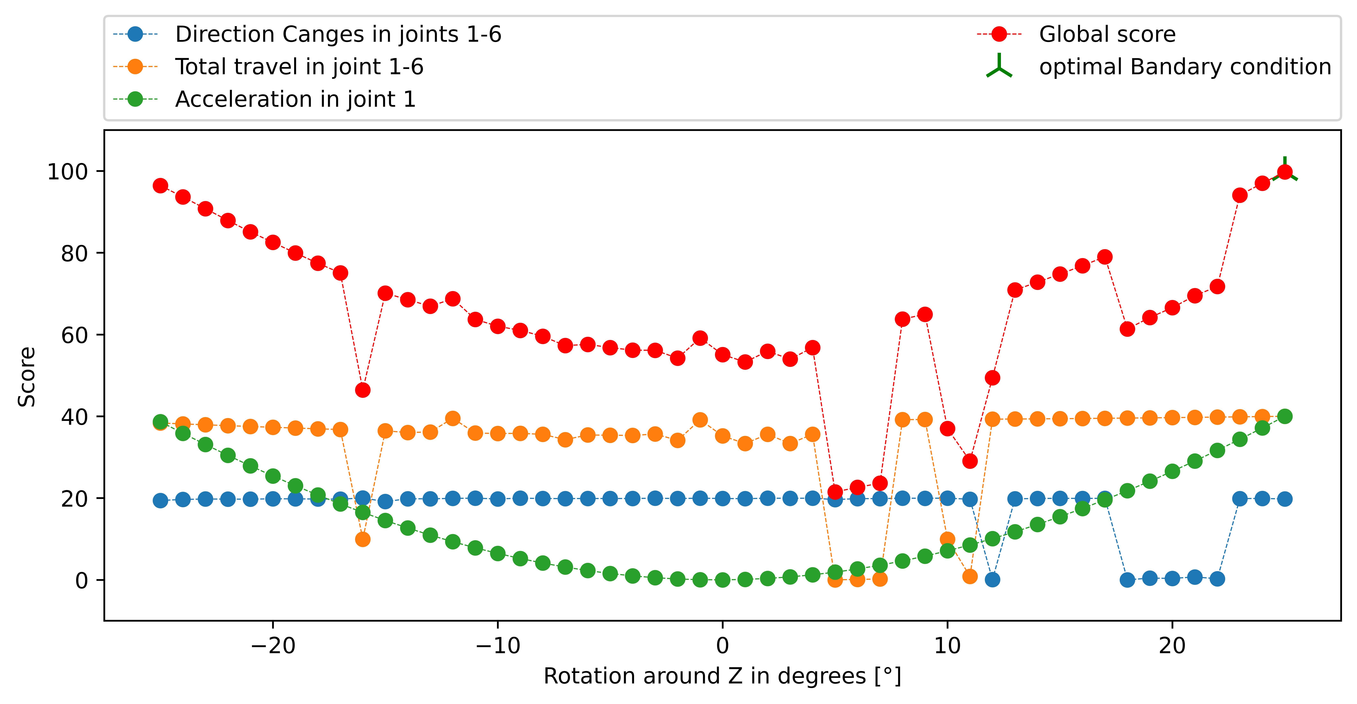
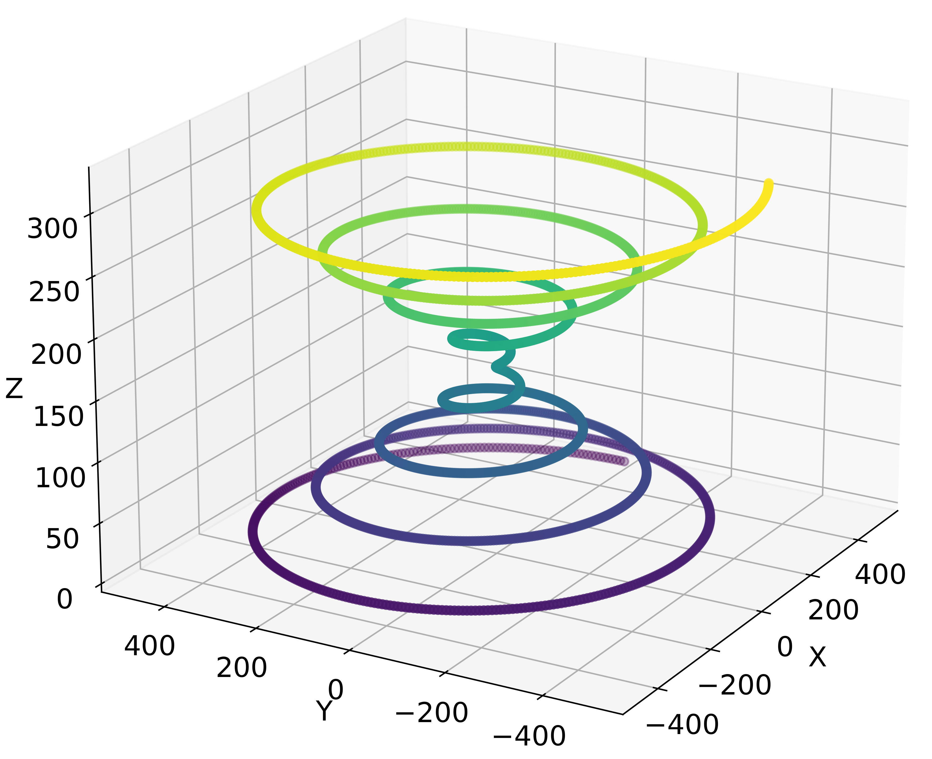
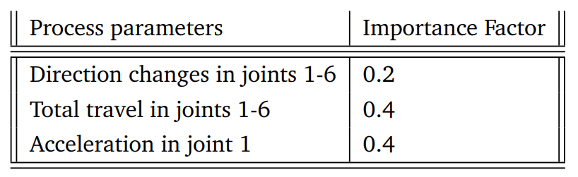
Results:
Toolpath 1

Slide 12
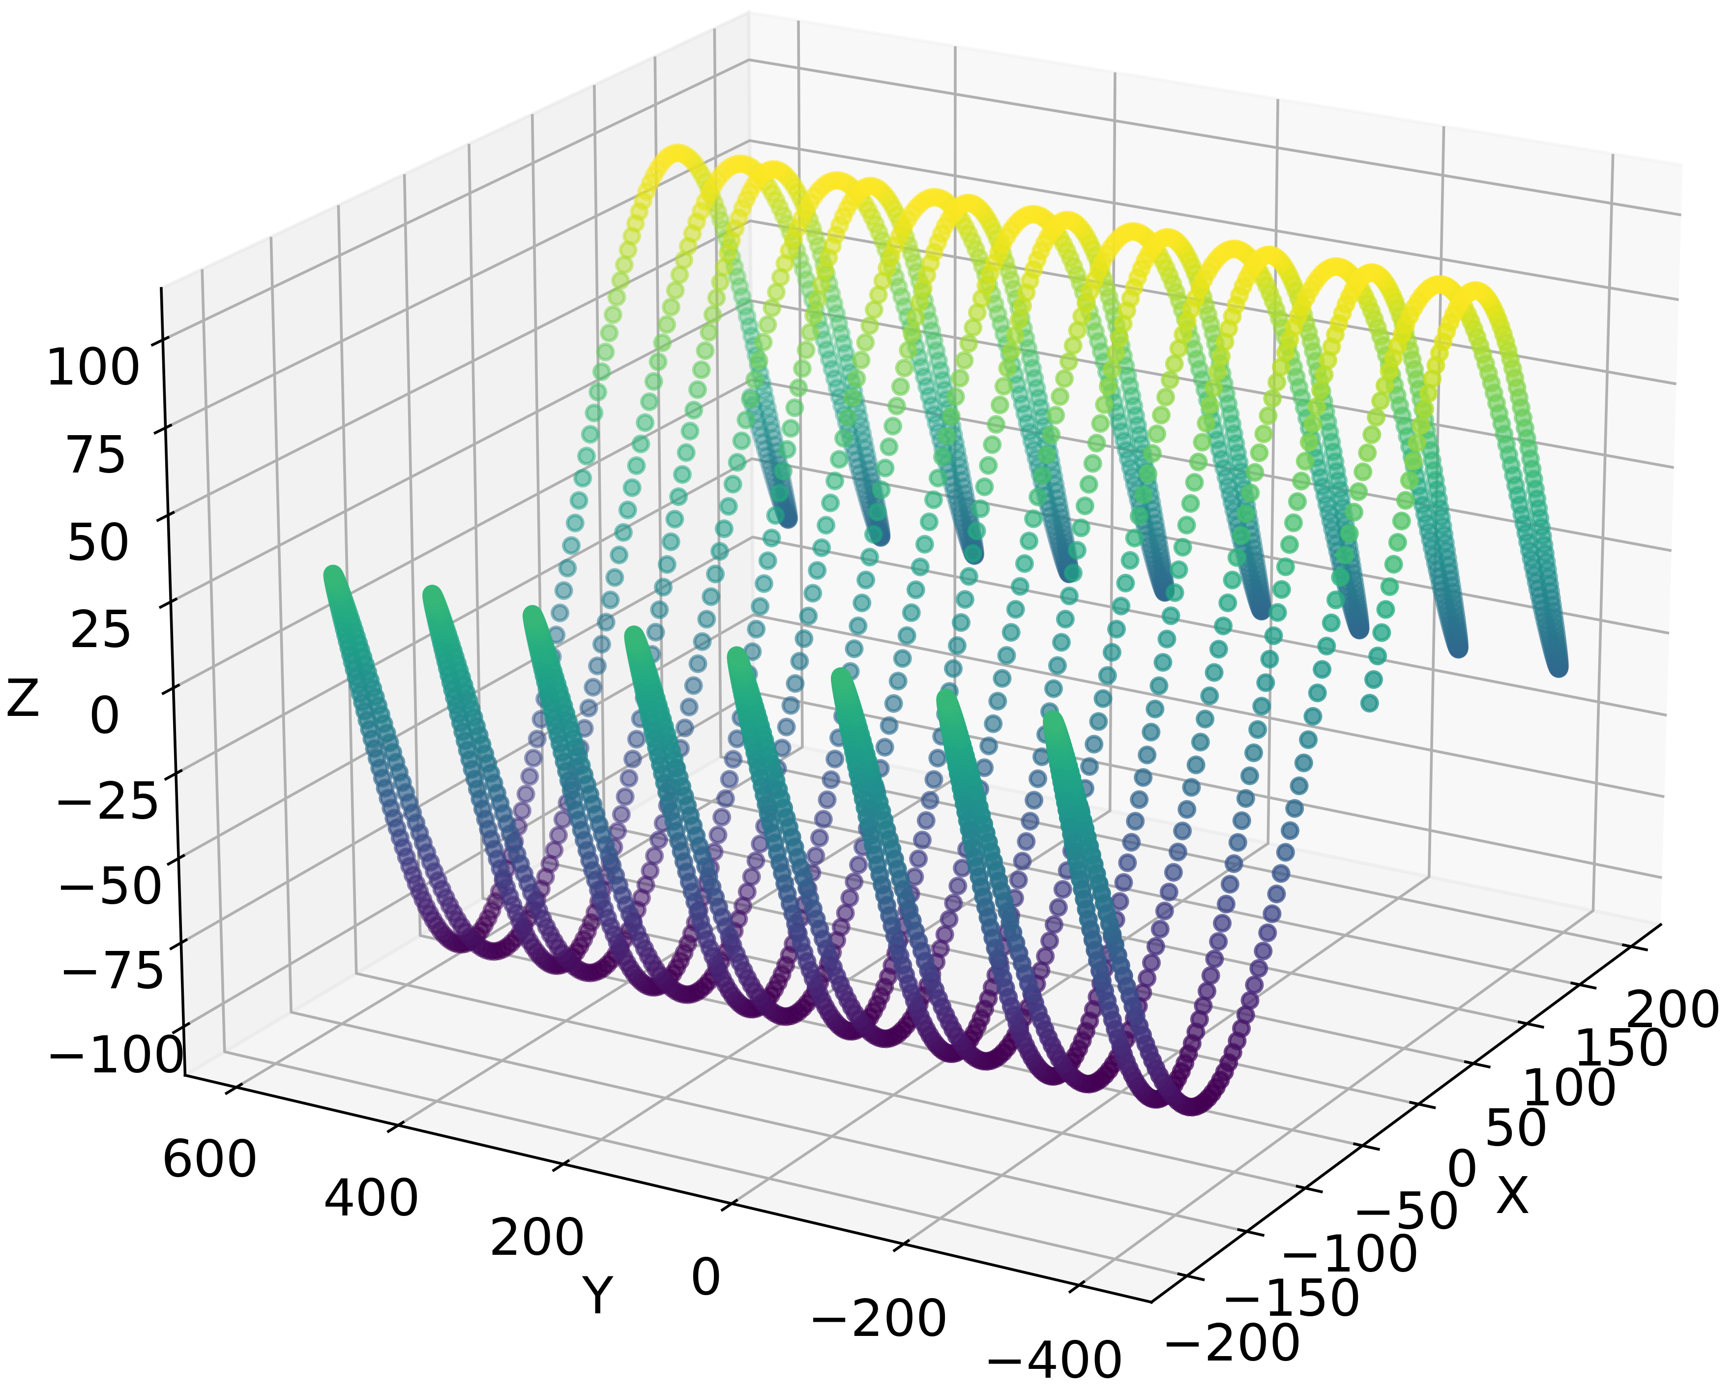
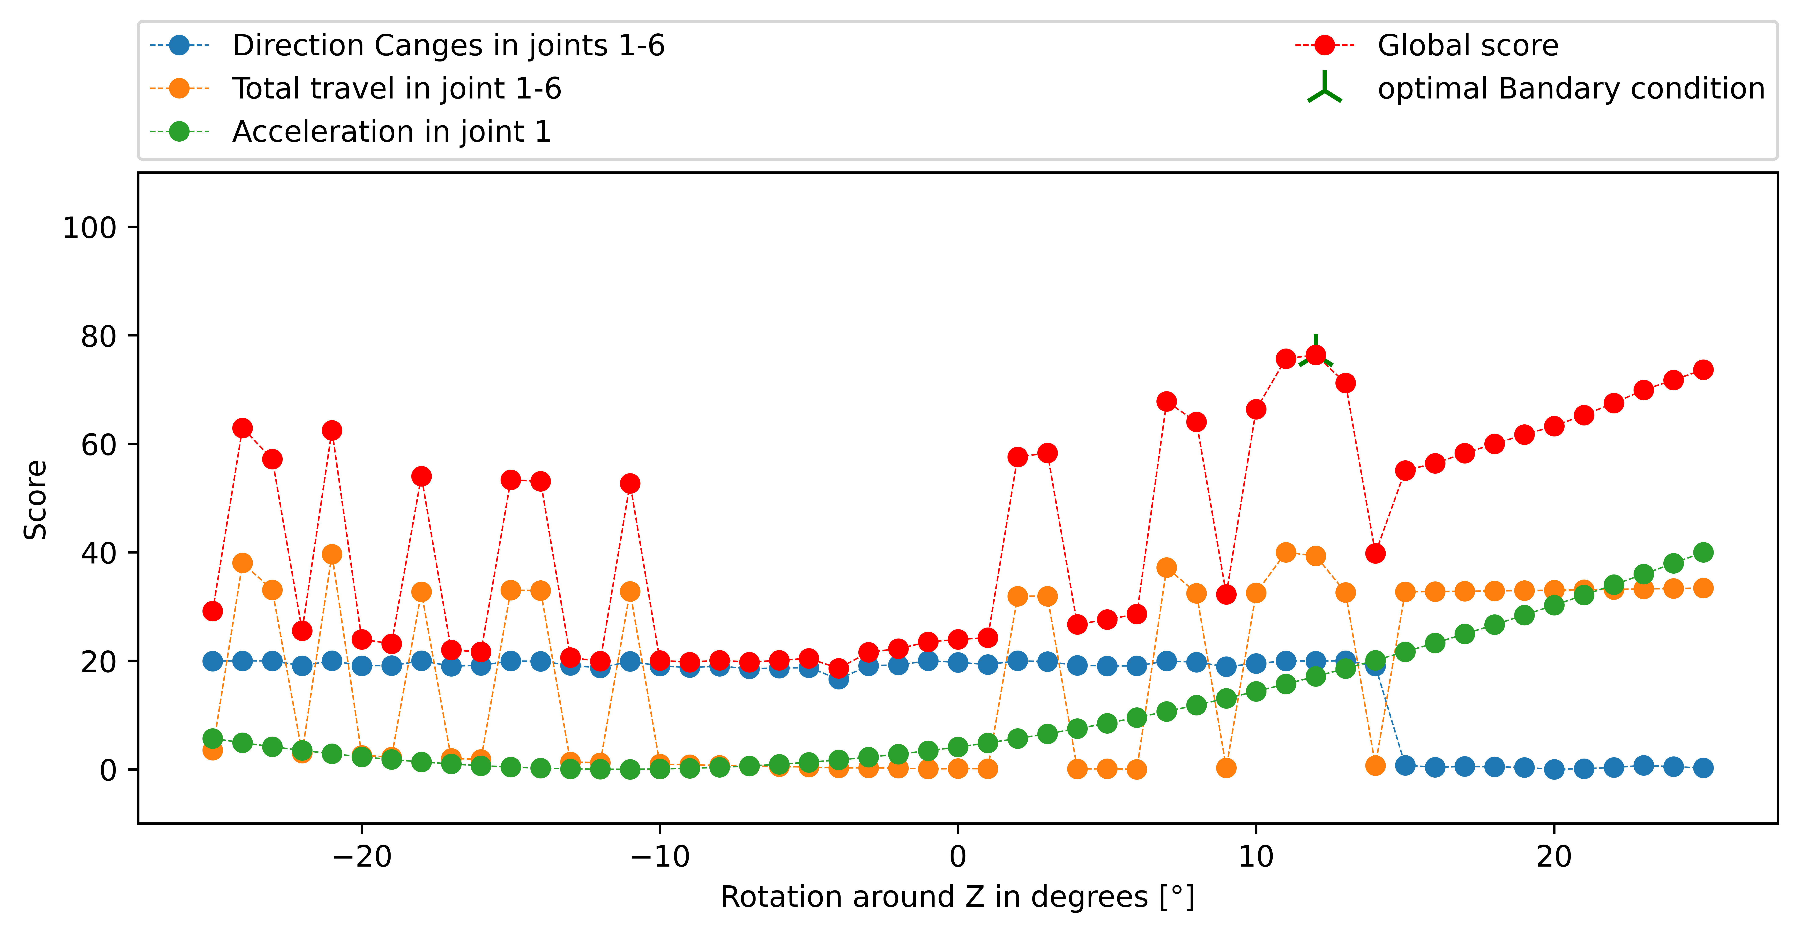
Results:
Toolpath 3

Slide 13
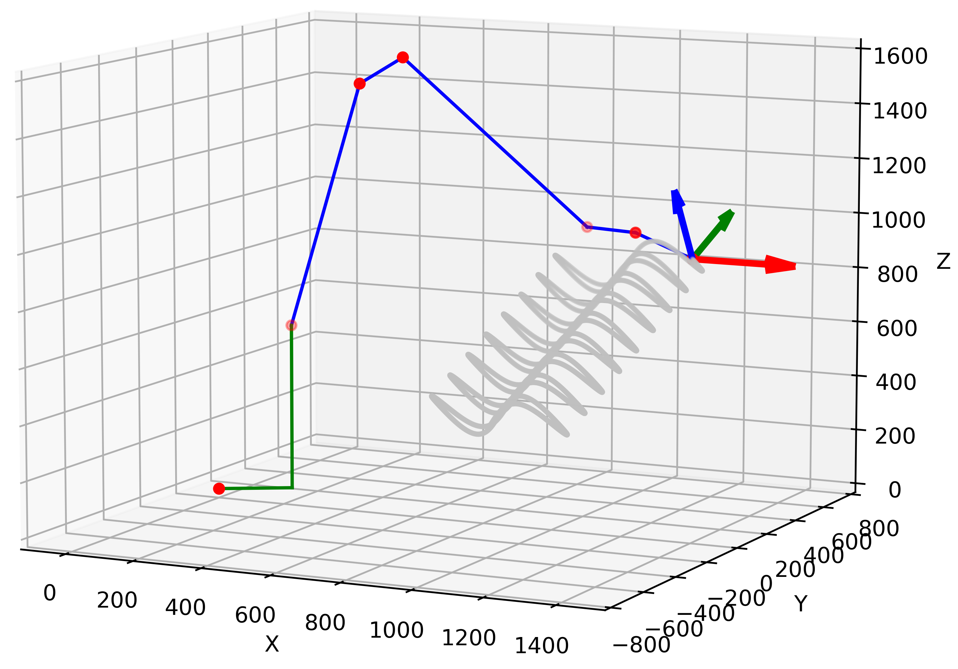
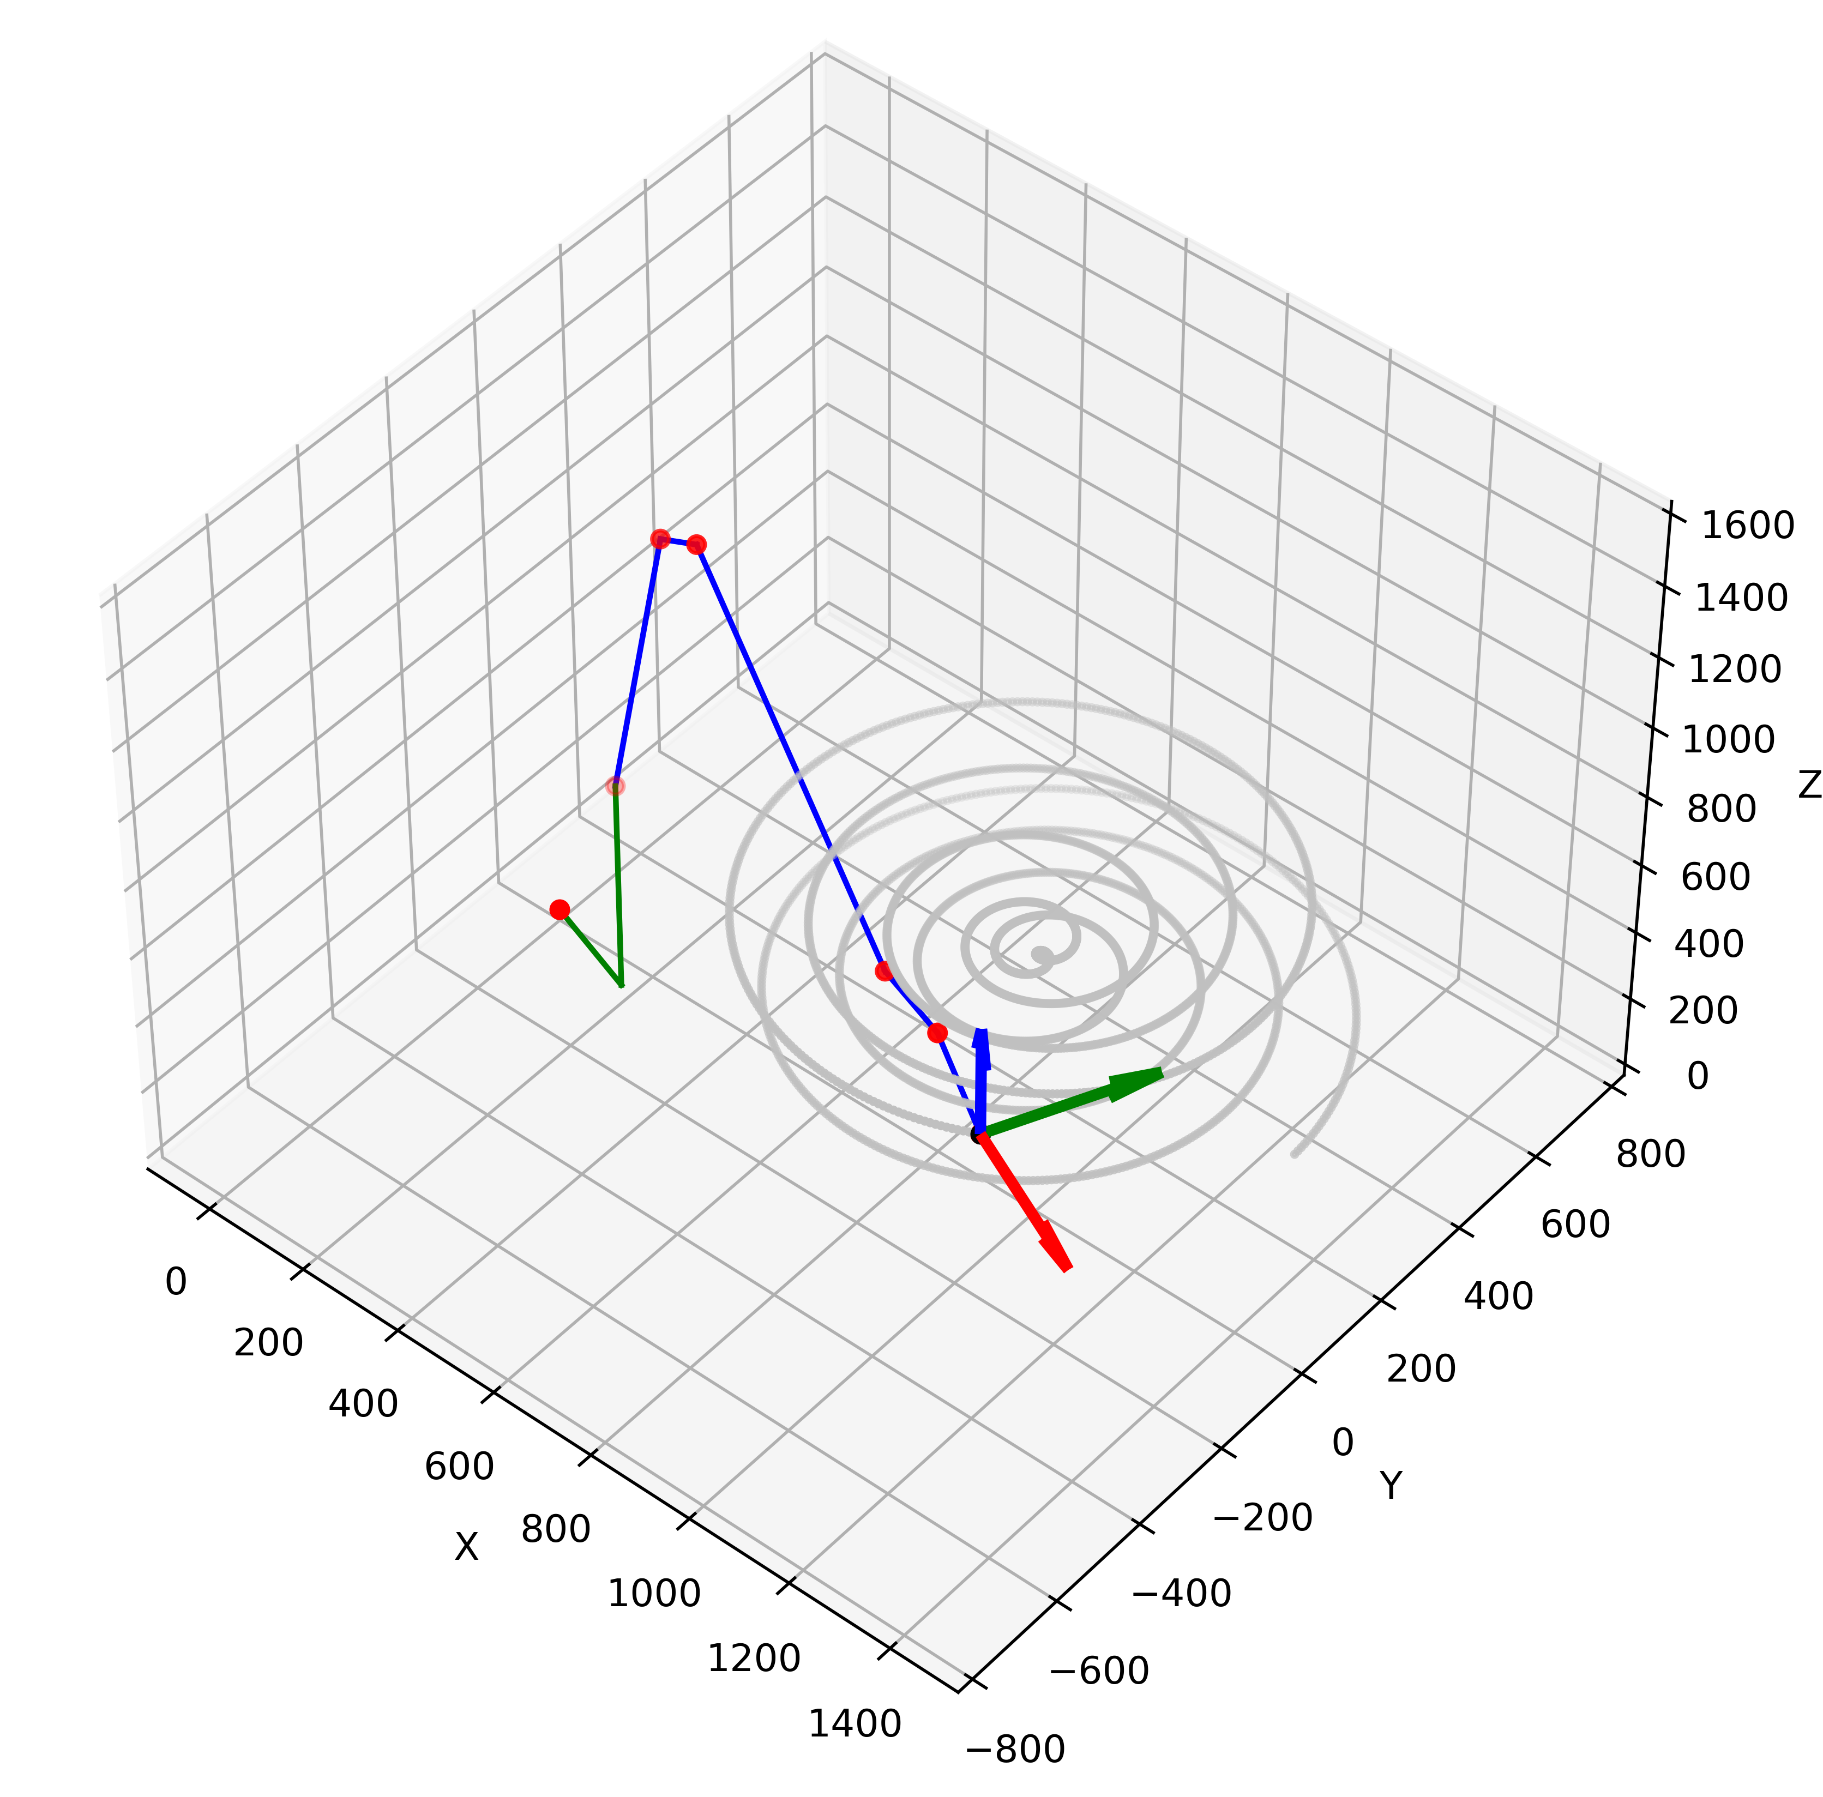
2 DoF
Tilt the toolpath
Rotation around Z
+

Slide 14
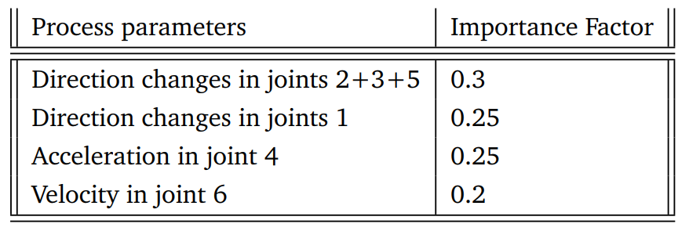

Slide 15
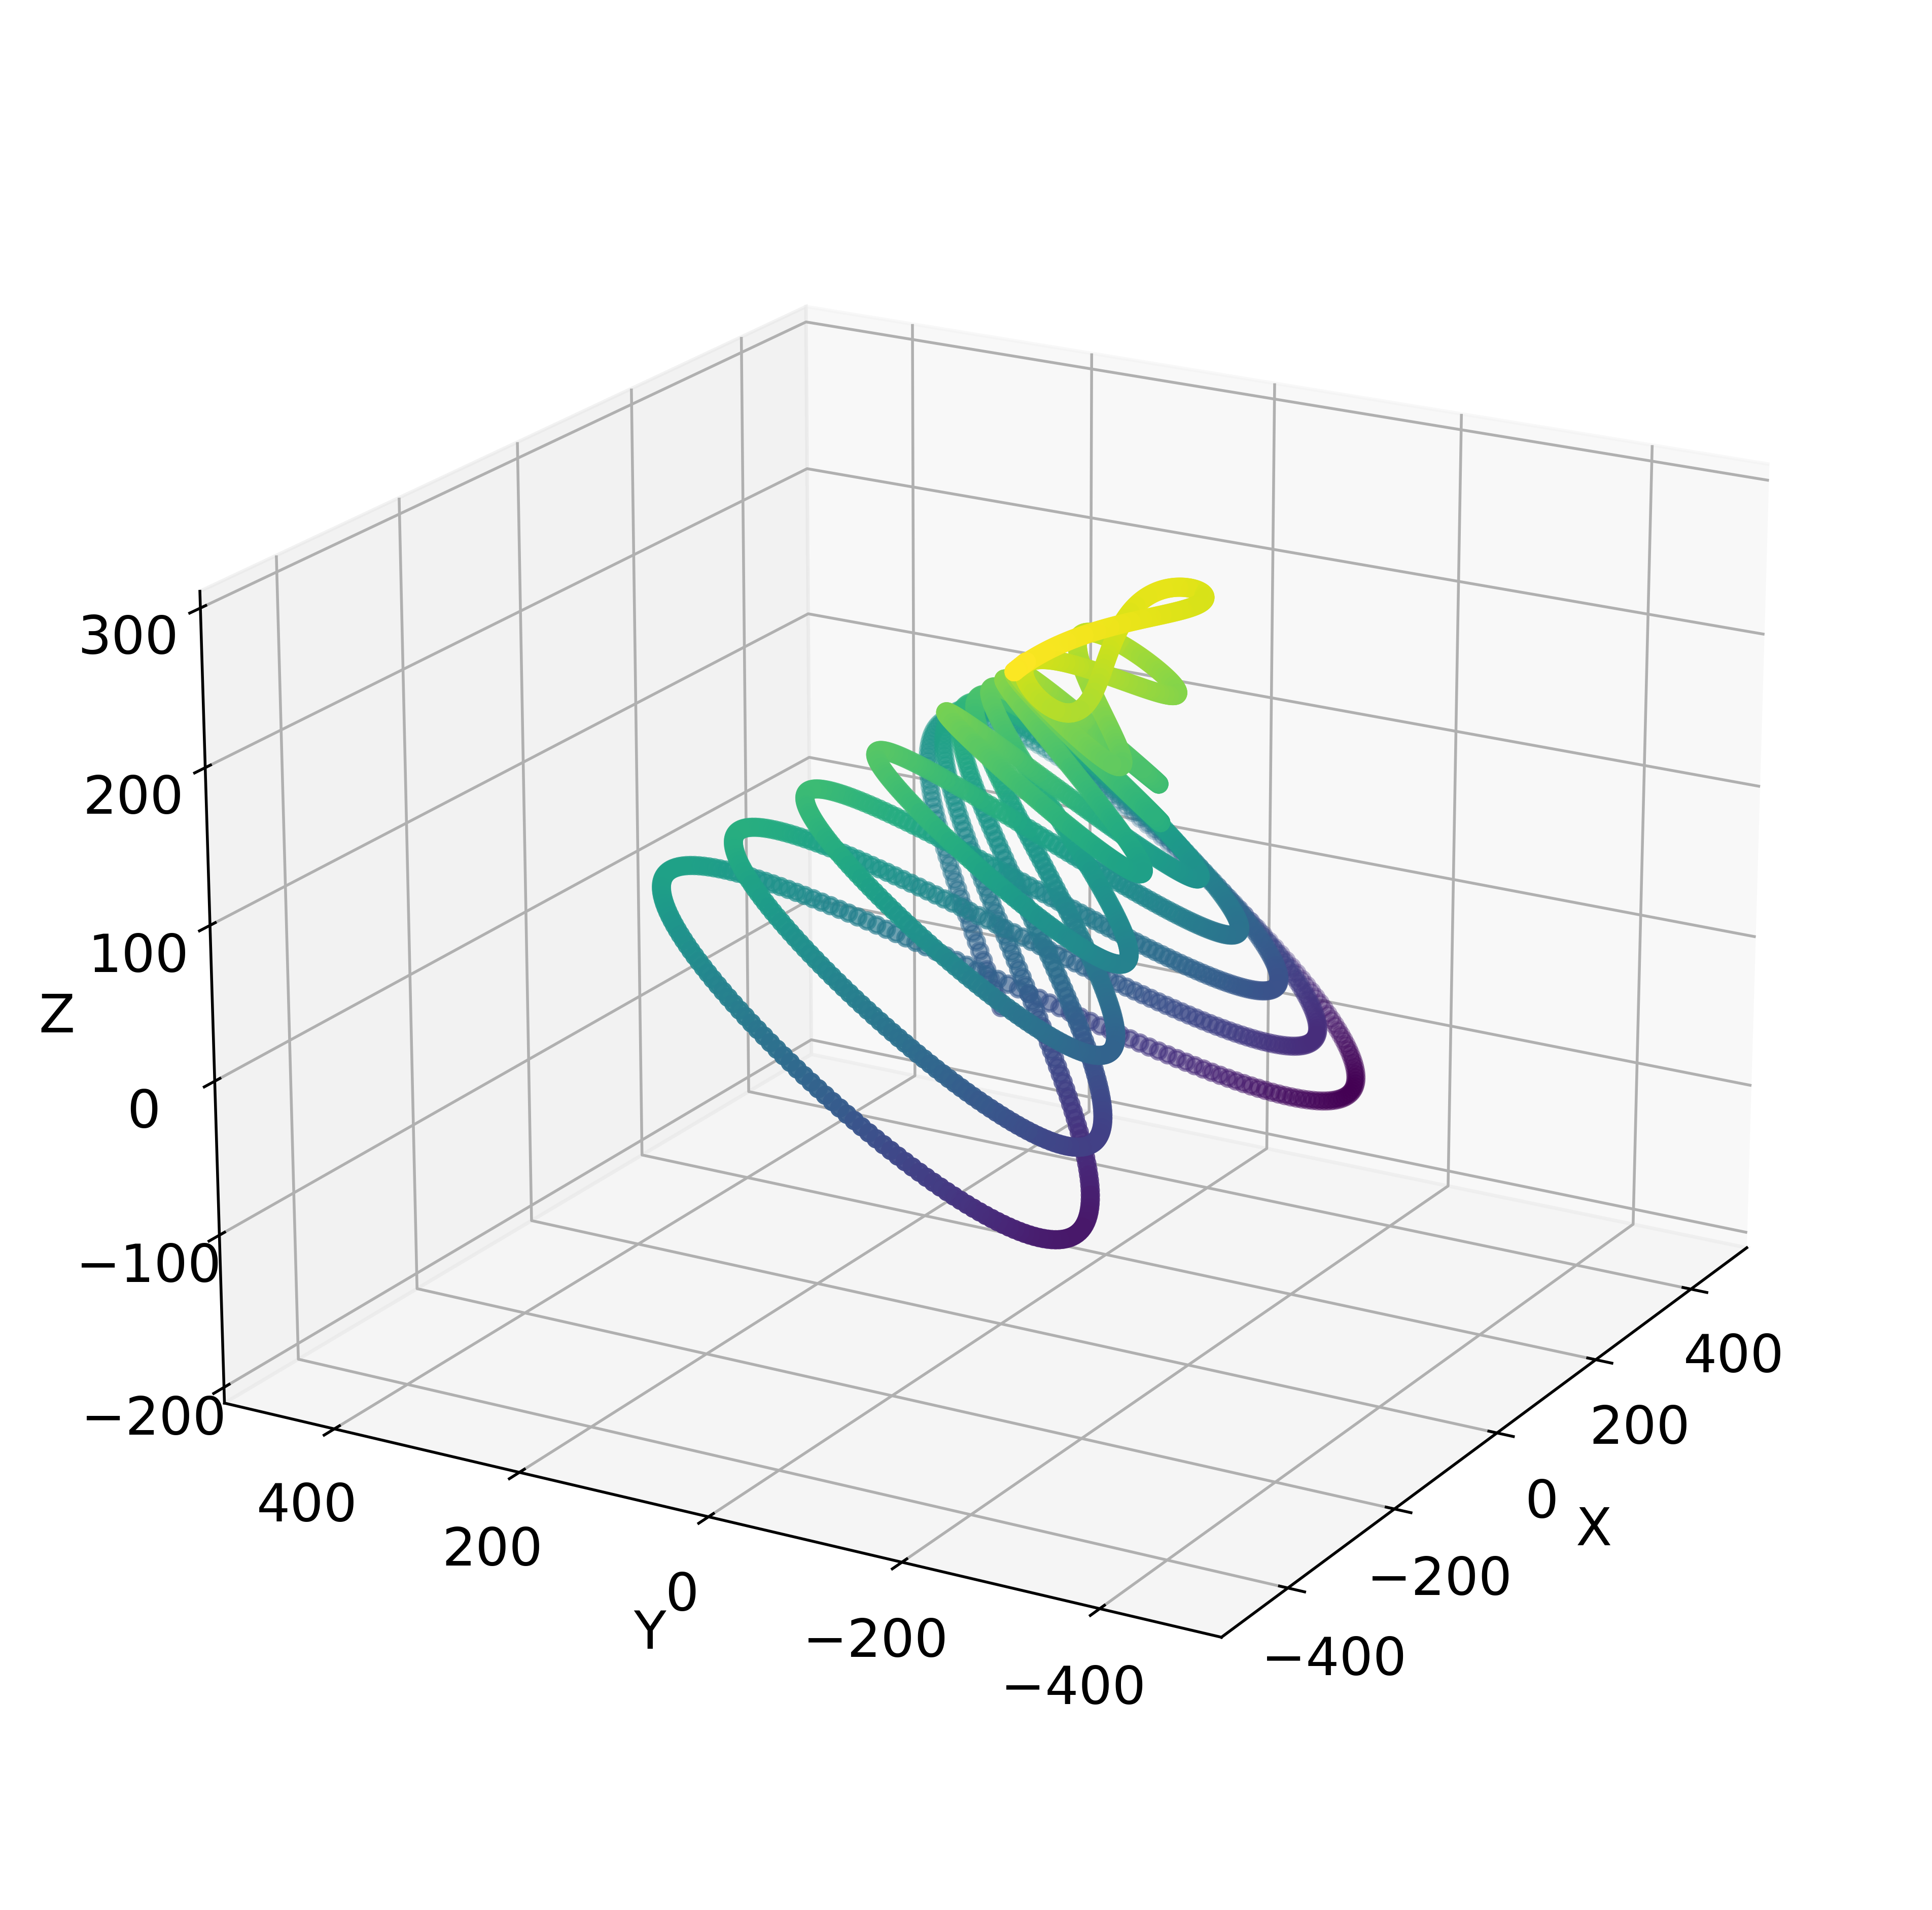
Average

Slide 16
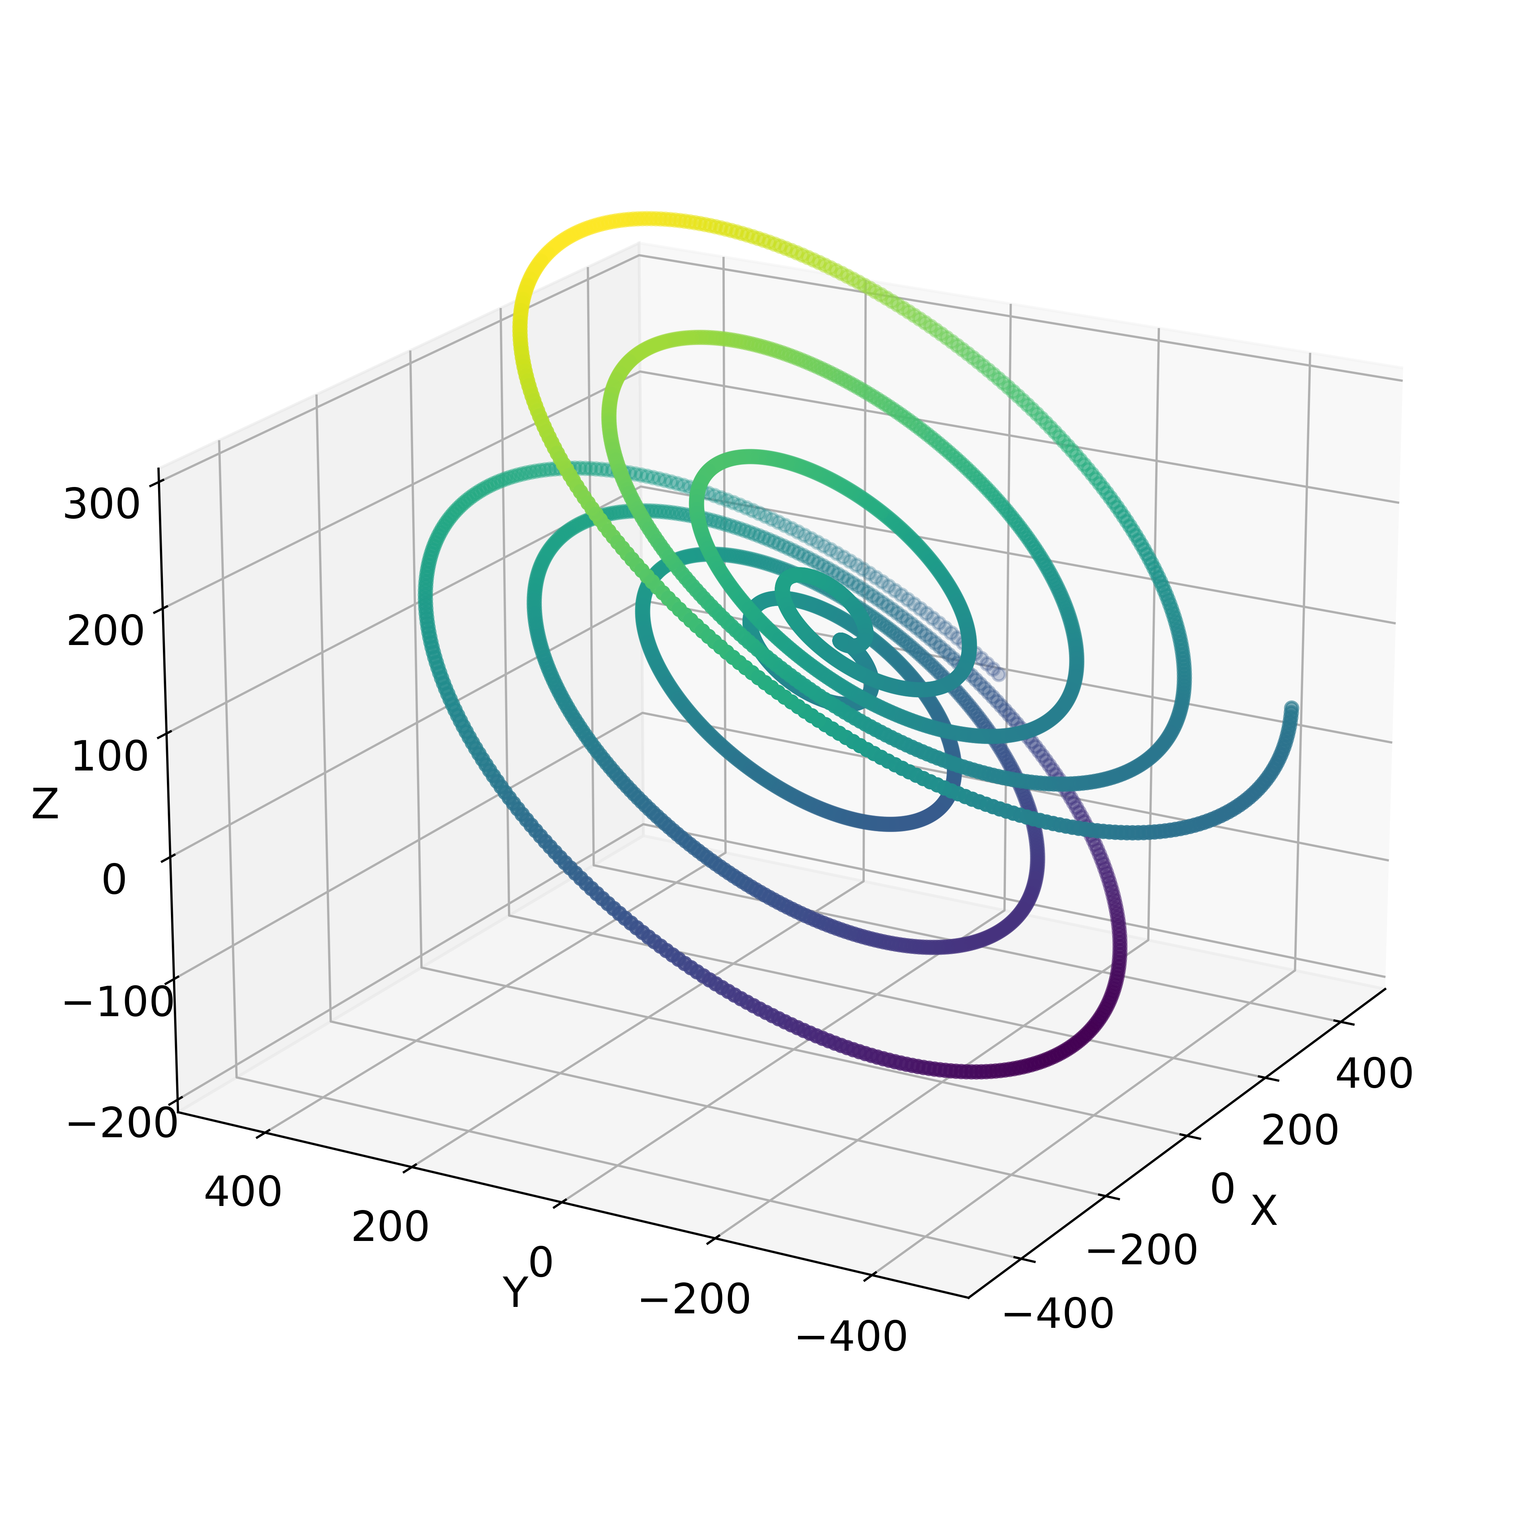
Average

Slide 17
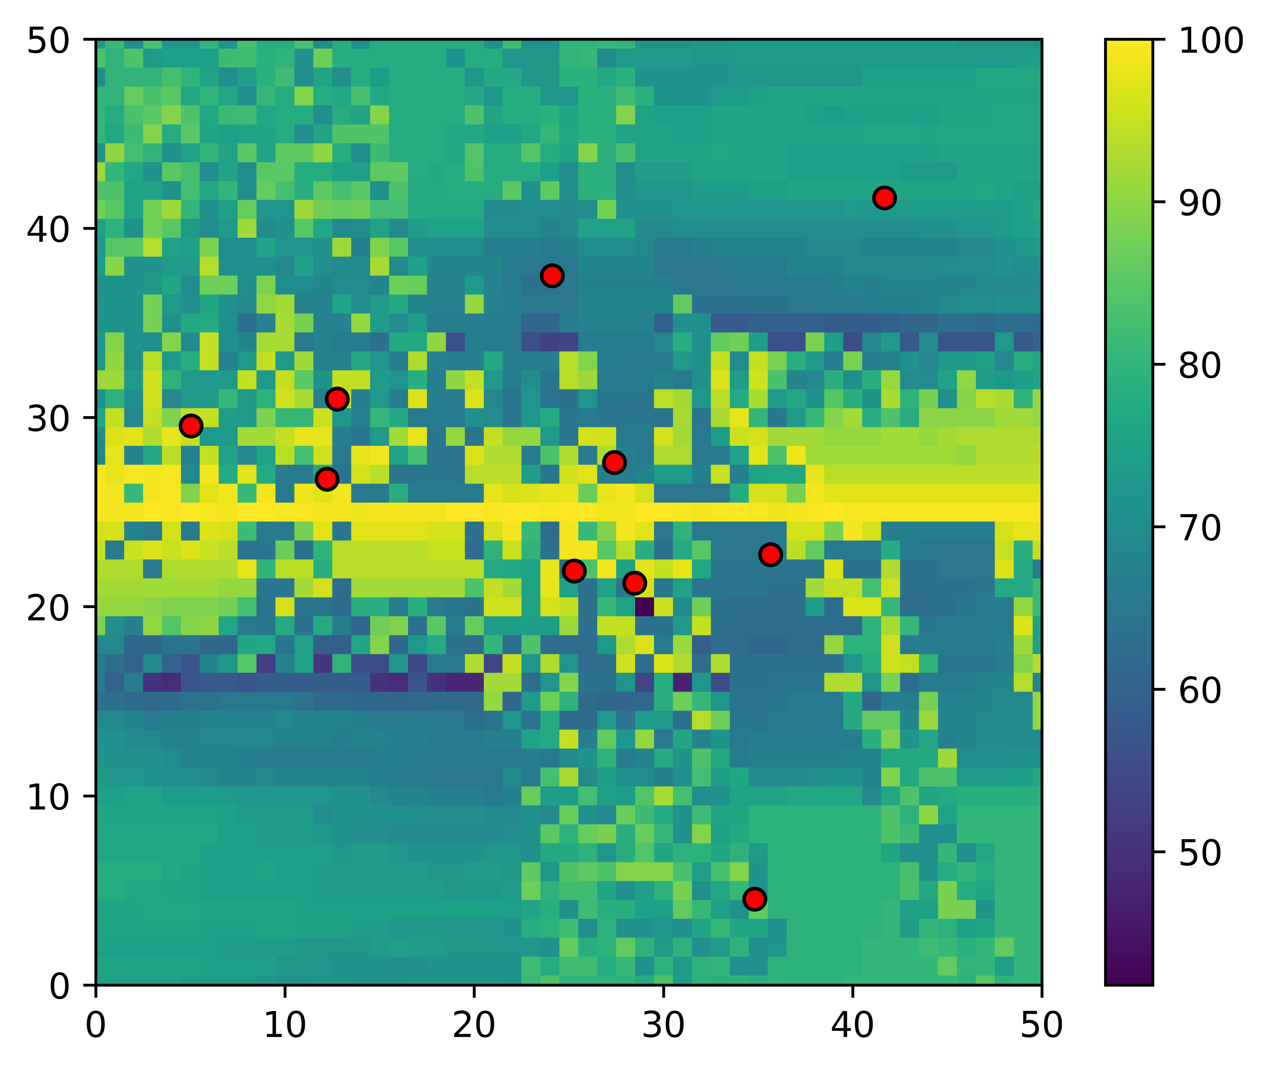

Swarm optimization:
!!! Show cool video here !!!

Slide 18
Problems + ToDo + Questions
Problem: - Berechnung dauert ewig (Multithread?)
- Swarm not working
- Nicht sicher ob die Berechnung der Matrix korrekt ist
- Explizit die Werte anschauen (Sprung in score)
ToDo: - Swarm weiter testen
- Berechnung prüfen
- Größerer wertebereich
- Gröbere Werkzeugbahn
Questions: - paper ?

Slide 19
Contact
Jan Nalivaika (TUM) Student Otto-Hahn-Ring 6
81739 Munich, Germany
Phone +49 163 7180148
E-mail jan.nalivaika.ext@siemens.com nalivaika@outlook.de
Marius Breuer (Siemens AG)
Supervisor Otto-Hahn-Ring 6
81739 Munich, Germany
Phone +49 (172) 8396287
E-mail marius.breuer@siemens.com
Ludwig Siebert (TUM-IBW)
Supervisor Boltzmannstr. 15
85748 Garching at Munich
Phone +49 (89) 289 – 15578
E-mail ludwig.siebert@iwb.tum.de

Slide 20
Christmas planning
DATE: Ludwig Marius Jan
08.12 ☺
15.12 ☺
22.12 ☺
29.12 X ☺
05.01 ☺
12.01 ☺
19.01 X
26.01 X
02.02 ☺

